Slide 1
Marketing Campaign Analysis
Presented by Oladejo A. Ayomide

Slide 2
Agenda
Introduction
Findings and insights
Code & methodology
recommendations
Conclusions & next steps

Slide 3
Introduction
This analysis explores the performance, effectiveness, and key insights from a recent marketing campaign. Through data-driven analysis, we’ll evaluate key metrics such as CTR (Click-Through Rate), CPC (Cost Per Click), ROI (Return on Investment), and engagement levels to understand the campaign effectiveness.

Slide 4
Findings & insights
Total acquisition cost was $3 billion with the least amount spent in February.
Average conversion rate of 0.08%.
ROI of $1 million with the lowest coming in February.
February generally had the lowest activities as it came last in every metric. Requires investigation.
All campaign types had very similar number of clicks, ROI, Impressions, acquisition cost and conversion rate.
There are 16,141 outliers in the CTR column and 16,040 in the CPC column.

Slide 5
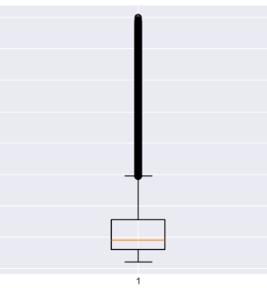
Code & Methodology
Code Used: plt.boxplot(x = 'CPC', data = df)
Code used to count number of outliers: CPC_outlier = df[df['CPC'] > 73.865]print("There are", len(CPC_outlier), "outliers in the CPC column")

Slide 6
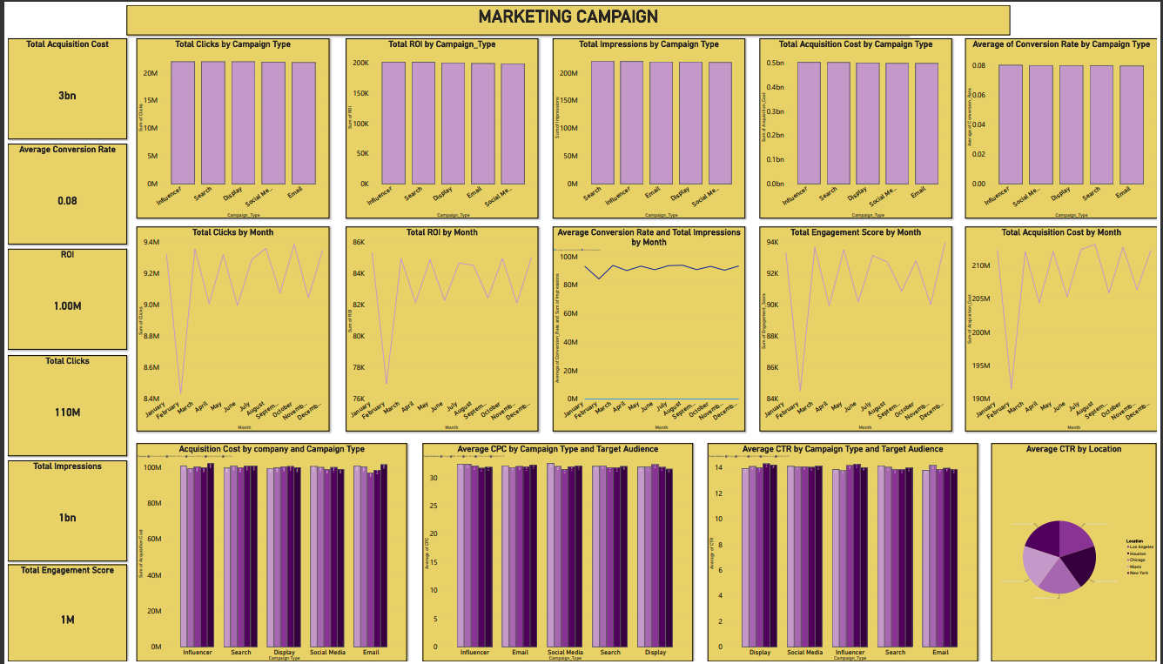
Visualization

Slide 7
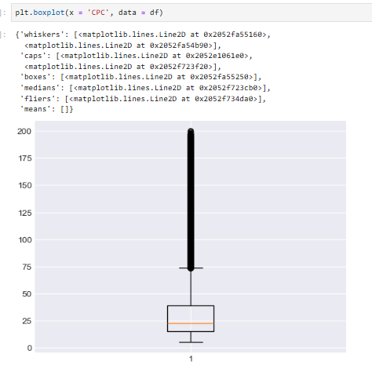
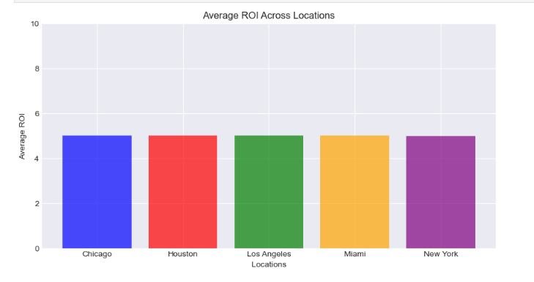
Visualization

Slide 8
Recommendations
Improve ad creatives, CTAs (Call-to-Actions), and landing page experiences to boost conversions.
Target high-intent audiences using better segmentation and personalized messaging.
Increase remarketing efforts to engage users who didn’t convert on the first interaction.
Consider experimenting with new marketing channels to diversify impact.

Slide 9
Conclusion
February Underperformed – It ranked lowest in all key metrics, requiring further investigation.
Low Conversion Rate (0.08%) – Needs optimization through better targeting, creatives, and landing pages.
ROI Needs Improvement – February’s poor performance impacted overall returns. Budget and strategy adjustments are needed.
Similar Performance Across Campaign Types – Indicates a need for differentiation or new targeting strategies.
CTR & CPC Outliers (16K+) – These anomalies may skew insights and should be analyzed for accuracy.

